Slide 1
L’ATTIVITÀ FISICA NEL PAZIENTE BARIATRICO
Prof. Monica Nannipieri
SOD Medicina dello Sport-AOUP
Dip. Medicina Clinica e Sperimentale
Università degli Studi di Pisa

Slide 3
bone and muscle outcomes in response to exercise

Slide 4
Exercise modulates potent beneficial effects to various metabolic organs impacted by obesity
Natasha Maria James

Slide 6
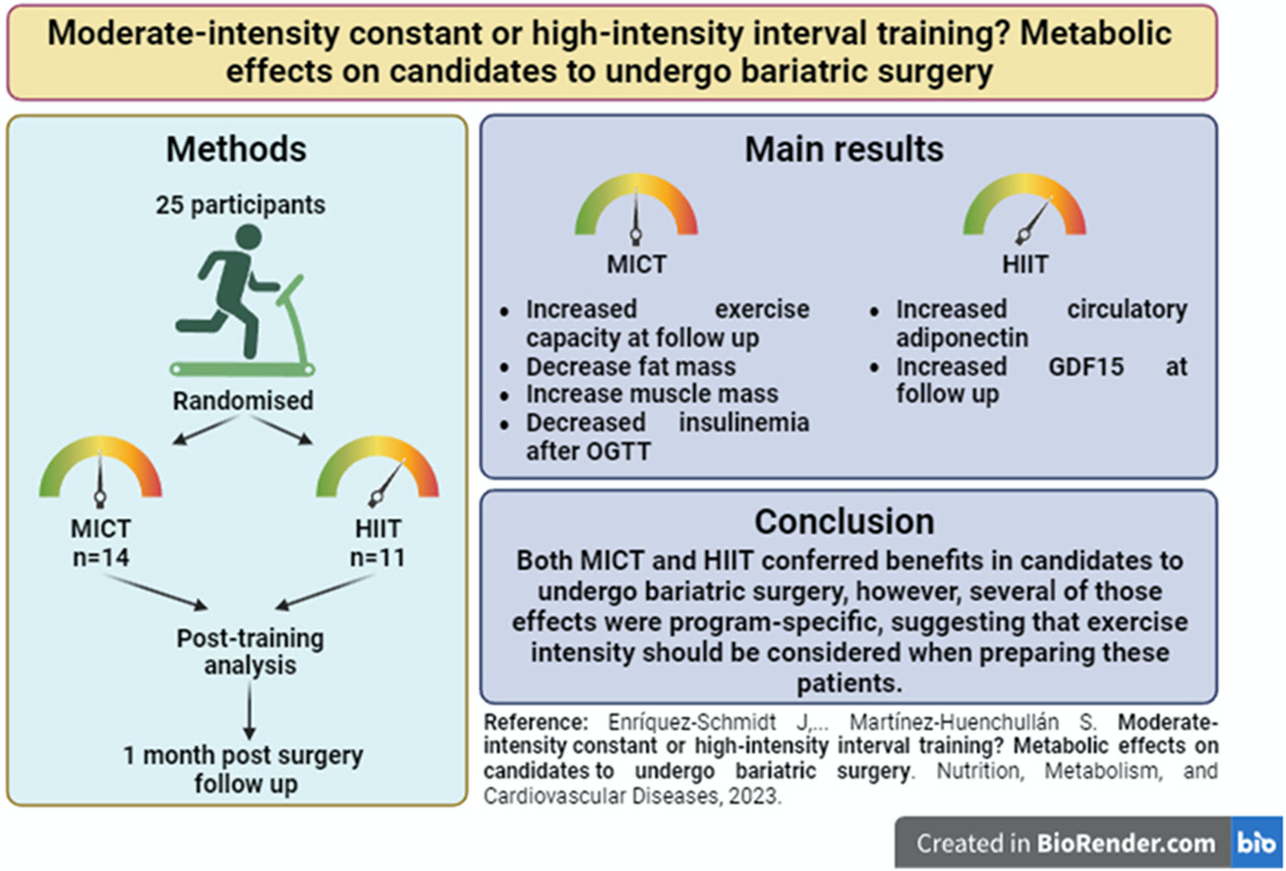

Slide 8
Excess weight loss over time in all groups.
Excess weight loss in:
PIG vs CG was + 3.47%, p<0.05
ST vs CG: + 3.66%
ET vs CG: +3.29 %

Slide 9
Fat mass loss in:
PIG vs CG was −3 kg, p = 0.0037
ST vs CG was −2.8 kg ET vs CG −3.2 kg
Fat mass over time in all groups.
Fat-free mass over 6 months:
PIG vs CG was + 0.2 kg; p = 0.79
ST vs CG was 0.2 kg
ET vs CG −0.2 kg
Conclusion An additional exercise training 6 months postoperatvely, independent of the type of training, resulted in greater weight loss and loss of fat mass. However, it had no effect on free fat mass, glucose/lipid parameters or inflammation beyond the surgery itself.

Slide 10
Week 3-4
The EXPOBAR trial showed that the intervention had significant and meaningful effects on body composition parameters, physical function, and strength outcomes. However, muscle mass decreased continuously after surgery in both groups despite the exercise protocol used in the intervention group.

Slide 11
In T2D individuals before surgery, PA showed significant reductions in blood pressure and a lower T2D recurrence (6.7 % vs 36 %) compared to No-PA group.

Slide 13
CONCLUSIONS

Slide 14
CONCLUSIONS

Slide 15
Grazie

Slide 16
CONCLUSIONS

Slide 17
Physiological adaptation to exercise training after bariatric surgery.
Mahmoud AM, Am J Phys Med Rehabil. 2022

